Slide 1


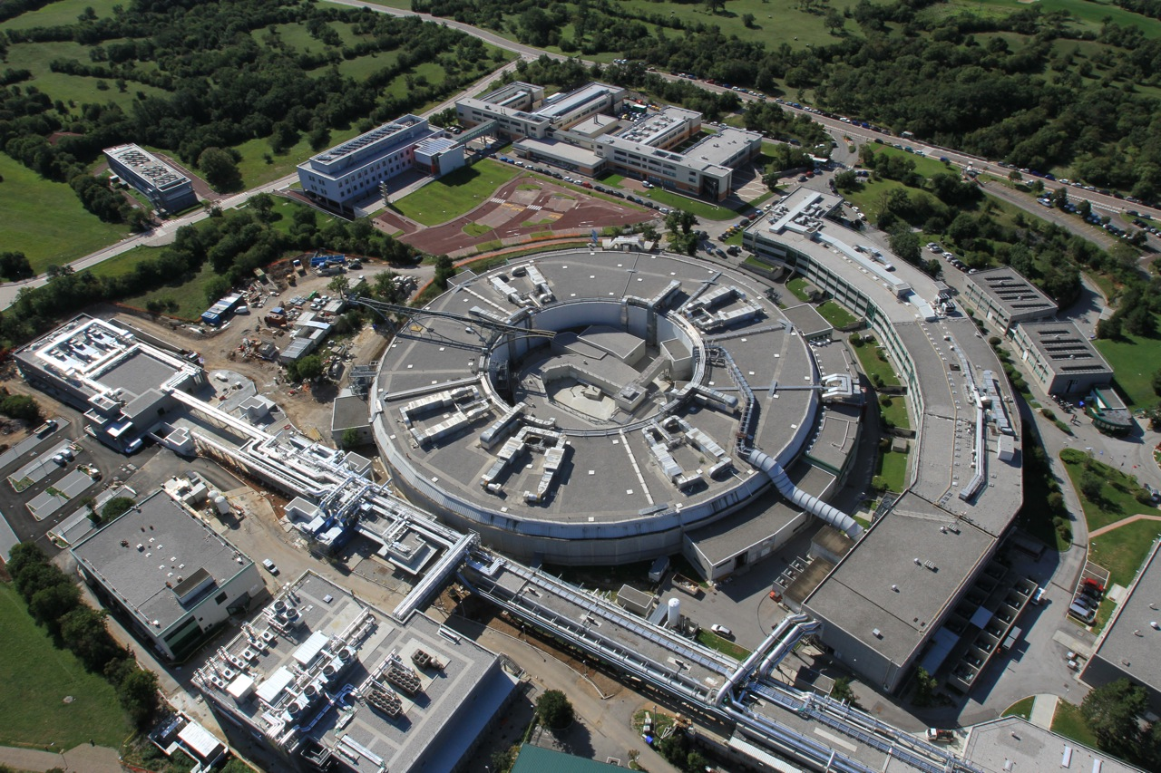
Studio di molecole di interesse ambientale
con nuove sorgenti nell’estremo ultravioletto (XUV)
Marcello Coreno
ISM-CNR and Elettra
Elettra Laboratory, AREA Science Park
34149 Trieste, ITALY

Slide 2
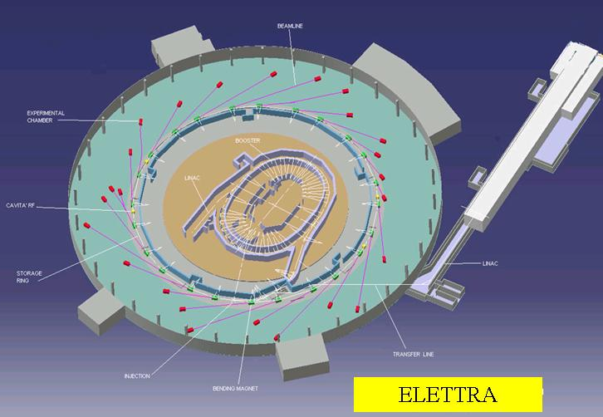
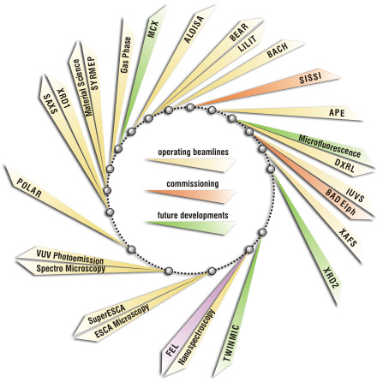
ELETTRA
from THz to Hard-X Rays
22 operating beamlines
2 in commissioning / upgrade
2 in construction
Storage ring R : 41.2 m
circumference : 259.2 m (walk around exp hall ~ 500m)
Beam energy [GeV] 2.0 2.4
Critical energy [keV] 3.2 5.5
Beam revolution [MHz] 1.157
Time between bunches (1 – 432) [ns] 864 - 2
9 beamlines Elettra-ST + CNR
3 under international agreement (A, CZ, IND)
Beam height: 1.3 m
12 bending magnets
11straight sections (4.8m)
GAS-PHASE Beamline
J. Sync.Rad. 5 (1998) 565-568.

Slide 3
Lorenzo Avaldi
Cesare Grazioli
Monica de Simone
Antti Kivimäki
Michele Alagia
Marcello Coreno
Carlo Callegari
Michele di Fraia
Oksana Plekan
Paola Finetti
Robert Richter
Kevin Prince
A group of researchers in the field of
Atomic and Molecular Physics
from Elettra-Sincrotrone Trieste and
the Italian National Research Council (ISM and IOM)

Slide 4
Investigation of the electronic structure of matter through photoionization of isolated species in gas phase
Targets and methods along axis of increasing complexity
Atoms, diatomics and triatomics
Coincidence techniques
radicals and metastables
(
γ
, 2e, ion), (
γ
, 2e
),
(
γ
,TPES)
[XeTeCo]
large polyatomics and high T vapours
TOF mass analysed photoionization
(bio)organics and organometallics
(PEPICO, and er-PEPICO)
PIFS and XES (dispersed, total)
aromatics, heteroaromatics, macrocycles
biobases, and aminoacids, metal-complexes,
AR-PES & resonant photoemission
Spectroscopy
Chemistry
PES and PIY, XPS and XANES
Laser desorbed or ablated materials (C_{n} , S_{n} , CdS)
Photoabsorption / photoionization
Clusters and Nanoparticles (Rg_{n} , Ti_{n} , C_{n} )
He droplets (pure and doped)
fluorescence, ion yield, electron yield

Slide 5
Introduction
“classical” synchrotron radiation
the Gas Phase Beamline
few examples
Spectroscopy
Novel light sources
CITIUS: a fs HHG VUV facility
across the Italo-Slovenian border
FERMI FEL and the LDM beamline
Dynamics
and
Photochemistry

Slide 6
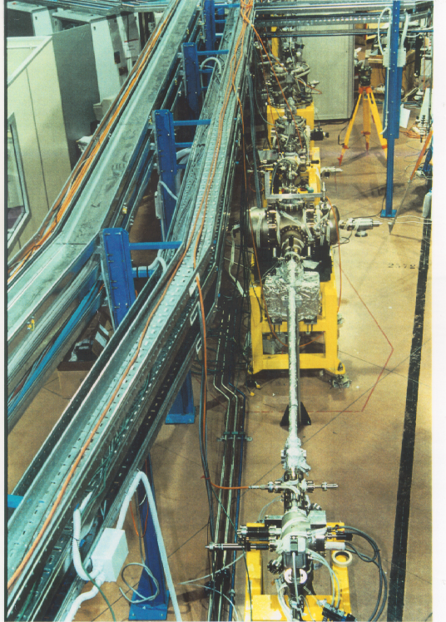
GasPhase Beamline: 1997-2019 a 22y facility for PCCP
www.elettra.eu/elettra-beamlines/gasphase.html
Broad Photon energy range: 13.5-1000 eV
High Resolving Power : E/ΔE>10.000
High Photon Flux : 10^{14_}10¹¹ photons/sec/100mA ring /1%o BDWT
10 end stations for photoabsorption, PES, fluorescence, mass spectrometry and advanced electron, ion and photon coincidence spectroscopies;
an external ps/fs laser available for two colour pump-probe experiments.
The BL can also accomodate user owned end-stations.
Since 1997 GasPhase has hosted more than 350 experiments, and produced almost 330 papers ( mean IF 3).
“Chemical complexity” of research proposal continuously increasing (atoms , molecules, clusters, nanoparticles, droplets).

Slide 7
XUV: 10-1000 eV
Excitation, Ionization and Decay Processes
Absorption Spectroscopy, XANES
absolute photoabsorption
Total Ion Yield (TIY)
Total Electron Yield (TEY)
Photoemission Spectrometry
Threshold (TPES)
VUV-PES, XPS
Auger Spectroscopy
Velocity Map Imaging (ARPES)
PIFS
Photon Induced Fluorescence Spectroscopy
total Fluorescence Excitation (FE )
Dispersed Fluorescence
mass spectrometry
Coincidence schemes:
e- - e- PEPECO
DTPESCo
APECS
e- - I+
TPICO
PEPICO
γ – I+ (PIFPICO)
γ – e- (PIFPECO)
γ – γ (PIFPIFCO)

Slide 8
Small metastable molecules of atmospheric relevance Core Excitation study of ¹Δ O₂
1s -> Π*
XANES
ω (K^{-1*}) ¹Π_{u}<ω (K^{-1*}) ³Π_{u}
FC analysis ~ 130 meV

Slide 9
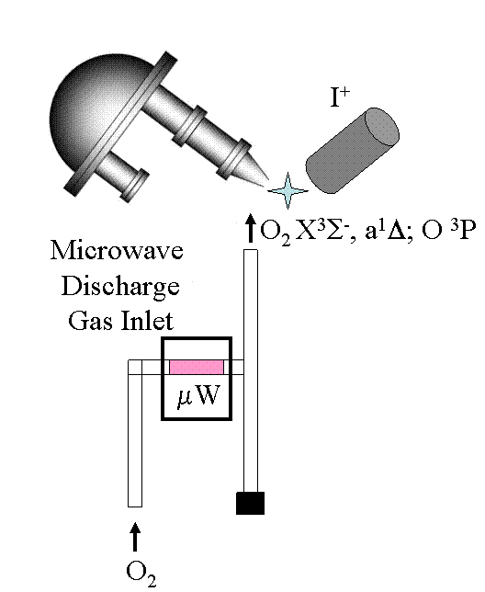
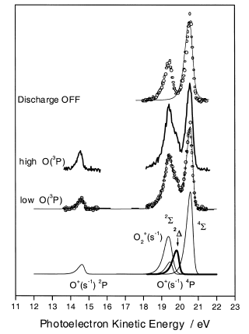
Metastable Oxygen
Experimental Setup and Diagnostics
XPS
hv = 564 eV

Slide 11

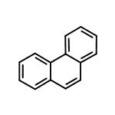
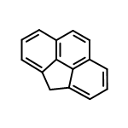
SR-PIMS of PAH
Scientific drive: database for soot analysis by XUV PhotoIonization Mass resolved Spectroscopy
phenanthrene and cyclopentaphenantrene
Carbon 1s XANES spectra
TOF-Mass spectrum at hv = 60 eV
C₁₄H₁₀
3
Phenanthrene
60x10
1400
++
[P]
Phenanthrene
1200
+
[P]
50
1000
+
[P-26]
40
800
Intensity [a.u.]
Intensity [counts]
++
[P]
4H-cyclopenta[def]phenanthrene
4H-cyclopenta[def]phenanthrene
600
30
C₁₅H₁₀
400
200
+
20
[P-26]
0
0
50
100
M [amu]
150
200
10
0
284
286
288
290
292
Photon Energy [eV]

Slide 12
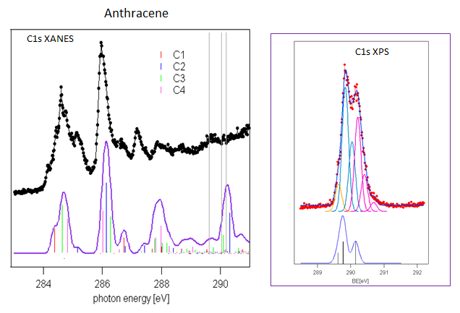
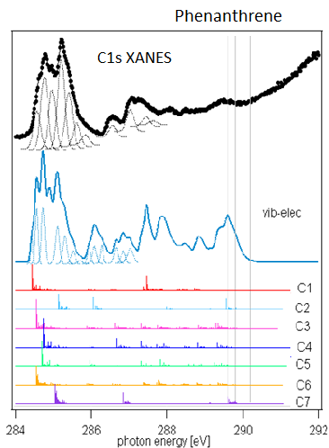
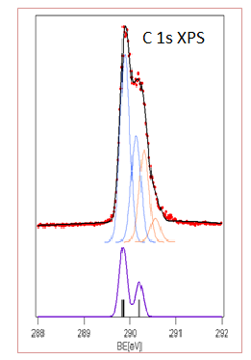
Clear differences appear in C1s
X-ray Absorption Near Edge spectroscopy
Vibronic structure must be taken into account for correct modeling of XANES
G. Fronzoni 2014, JCP 141, 44313
A. Acocella 2016, PCCP 18, 13604

Slide 13

Cluster Experiment with Synchrotron Radiation
“CESyRa”
P. Piseri, P. Milani, et al.
CIMAINA & UniMi
and GasPhase
Neutral free clusters from a pulsed microplasma cluster source (PMCS)
Motivation: tailor nanostructured materials through fine control of building blocks properties during the synthesis
Clusters of titanium, titanium oxide, carbon and magnesium have been investigated by XAS

Slide 14

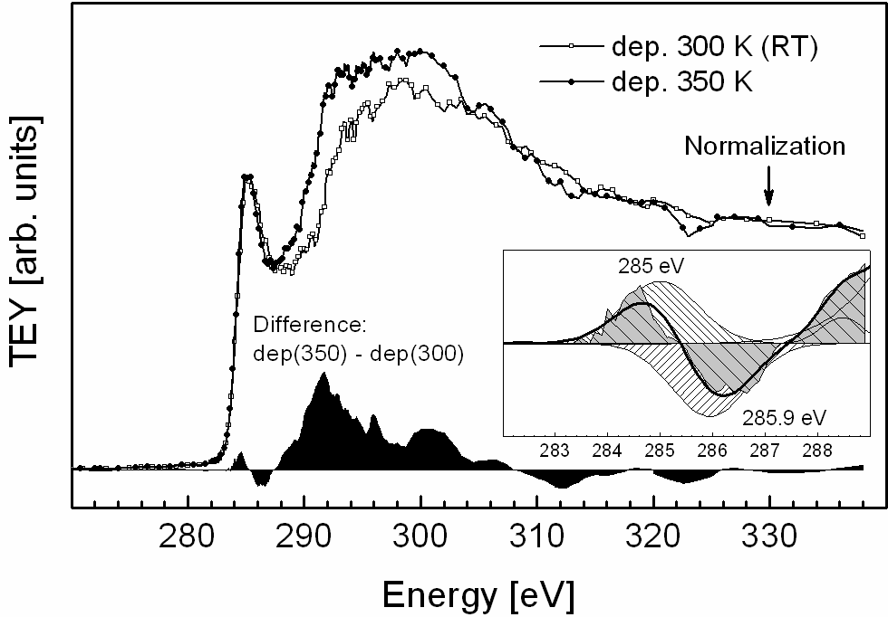
PIMS of Carbon Clusters
Identify and quantify carbinic structures by C 1s XANES
XANES of in situ deposited thin film

Slide 15
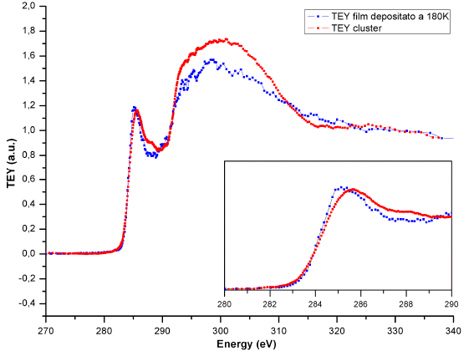

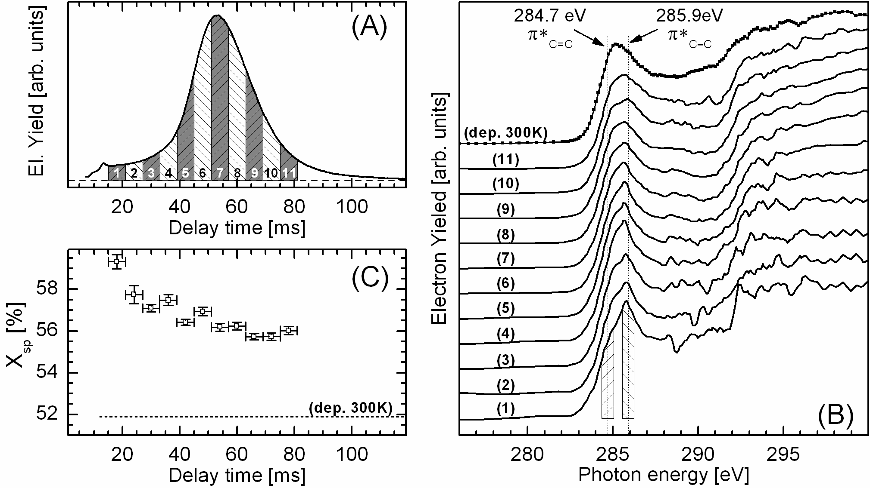
-
n
-
thin
film @ 180 K
-
n
-
TEY cluster
The gas phase experiment shows a small, but clear shifts of the K->π* excitation toward higher photon energy.
Longer residence time in the PMCS corresponds to better thermalization.
Shorter residence times -> higher degree of carbynoid metastable structures
Electron yield measured for free carbon NPs as a function of the delay time between the PMCS discharge and the electron detection (i.e. the NP residence time in the source).
(B) XANES spectra of NP assembled film (300K) and free NPs for 11 delay time windows in (A). The acetylene and ethylene π* resonances are indicated as dotted lines.
(C) Evolution of carbynoyd fraction X_{sp} with delay time; the value of X_{sp} for the deposited film is indicated as a dashed line.
L. Ravagnan, Chem. Comm 2011

Slide 16
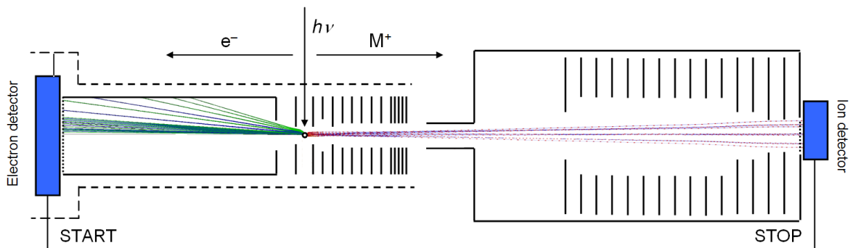
CESyRA
«On the flight» study of NP XANES
Photo Electron Photo Ion Coincidence spectroscopy (PEPICO)
Velocity Map Imaging (VMI) position sensitive detector
Time of Flight spectrometer
Allows to extract photoelectron spectra in coincidence with selected positive ions
Perspectives: coupling to flame supersonic source for in – flight soot analysis
e.g. F.-X. Ouf 2016, Scientific Reports 6, 36495

Slide 17


3rd generation SR facilities
high accuracy for stationary electronic properties and energetics of fragmentation processes of isolated gas phase species
But how to characterize potential energy surfaces of chemical rearrangements?
And what about very low density samples, clusters, metastable or thermolabile molecules ?
Ultrafast Photoemission for Chemical Dynamics
Novel sources
high flux and short pulse light sources,
analog to laser radiation
fs VUV radiation with higher flux/pulse !
LDM@ FERMI: FEL is the next generation
synchrotron source, with fs- pulse duration
and high flux in the VUV and Soft X-Rays
CITIUS: fs-VUV laboratory laser HHG source
(an Ita-Slo Interreg FPVII initiative)

Slide 18
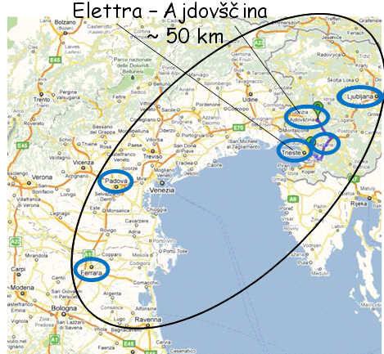
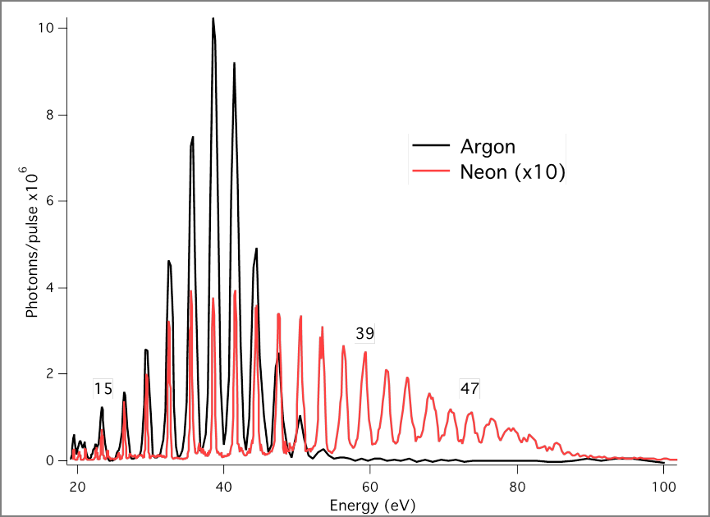
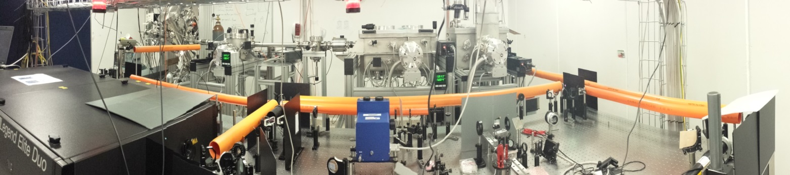

CITIUS
Centro Interregionale di Tecnologie Fotoniche Ultraveloci per la Spettroscopia
Interregional Center of Ultra fast Photonic Technology for Spectroscopy
Building up on the experience of “EUFOS”, the prototype storage ring FEL, a laboratory for ultrafast spectroscopy and femtochemistry based on a state-of-the-art VUV fs laser HHG source has been assembled at Elettra with EU-Interreg funding, and then moved to Uni NovaGorica (Ajdovščina campus, SLO). The scientific case on pump-probe experiments is developed in close collaboration with the LDM beamline of FERMI.
hv: 14 – 80 eV
C. Grazioli. et al, 2014 Rev. Sci. Instrum., 85 2304
www.ung.si/en/research/laboratory-of-quantum-optics/about/

Slide 19

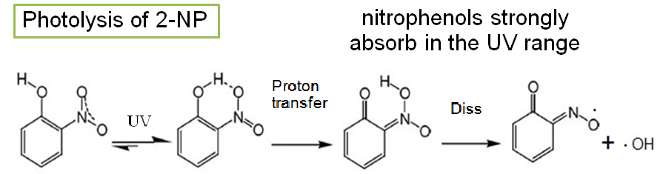

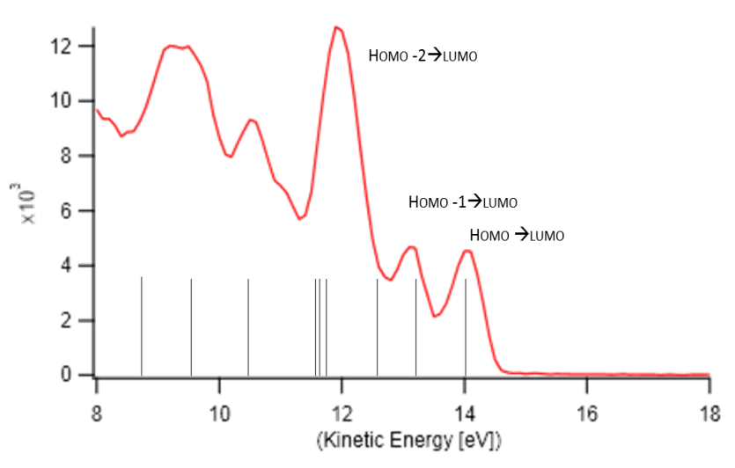
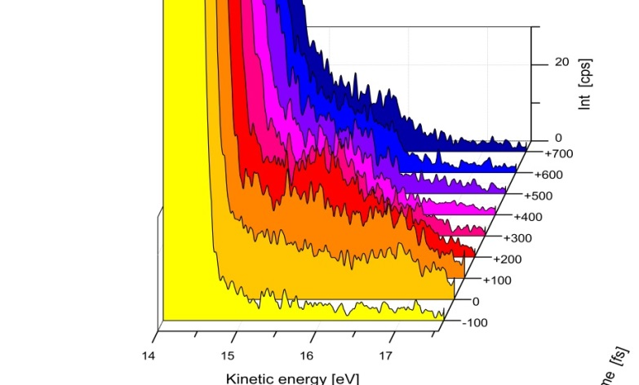
Atmospheric photochemistry
Ultrafast dynamics of VOC
2-nitrophenol
or
2-np Valence UPS
RISE AND DECAY OF ADDITIONAL BANDS AS A FUNCTION OF TIME DELAY
PES temporal profile
Δt: -100÷ 700 fs
Steps: 100 fs
+ UV pump
268 nm
GS -> S₂
Pump Ti:Sa H3 (268 nm) excitation (4,6eV)
Probe H15 ( 53.66nm) ionization (23,1 eV)

Slide 20
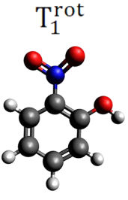
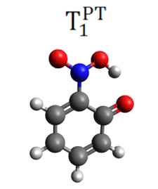
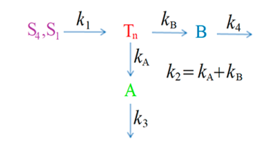
TR-PES of excited 2-NP
PES temporal profiles integrated over specific binding energy regions
TRPES 2D-map
pump: 268 nm, probe by 23.2 eV
Proposed triplet
doorways for
OH and HONO loss
A. Ciavardini, 2019
J. Phys. Chem. A 123

Slide 21

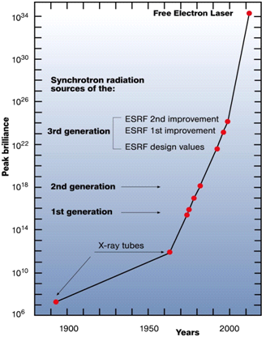
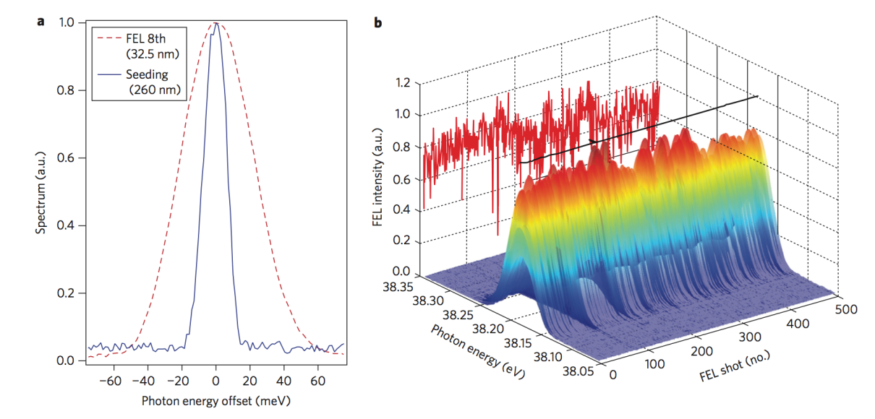
FERMI FEL
Our 4th generation synchrotron source
Linac klystron gallery
GW power levels (50-500 fs) 10/50 Hz

Slide 22

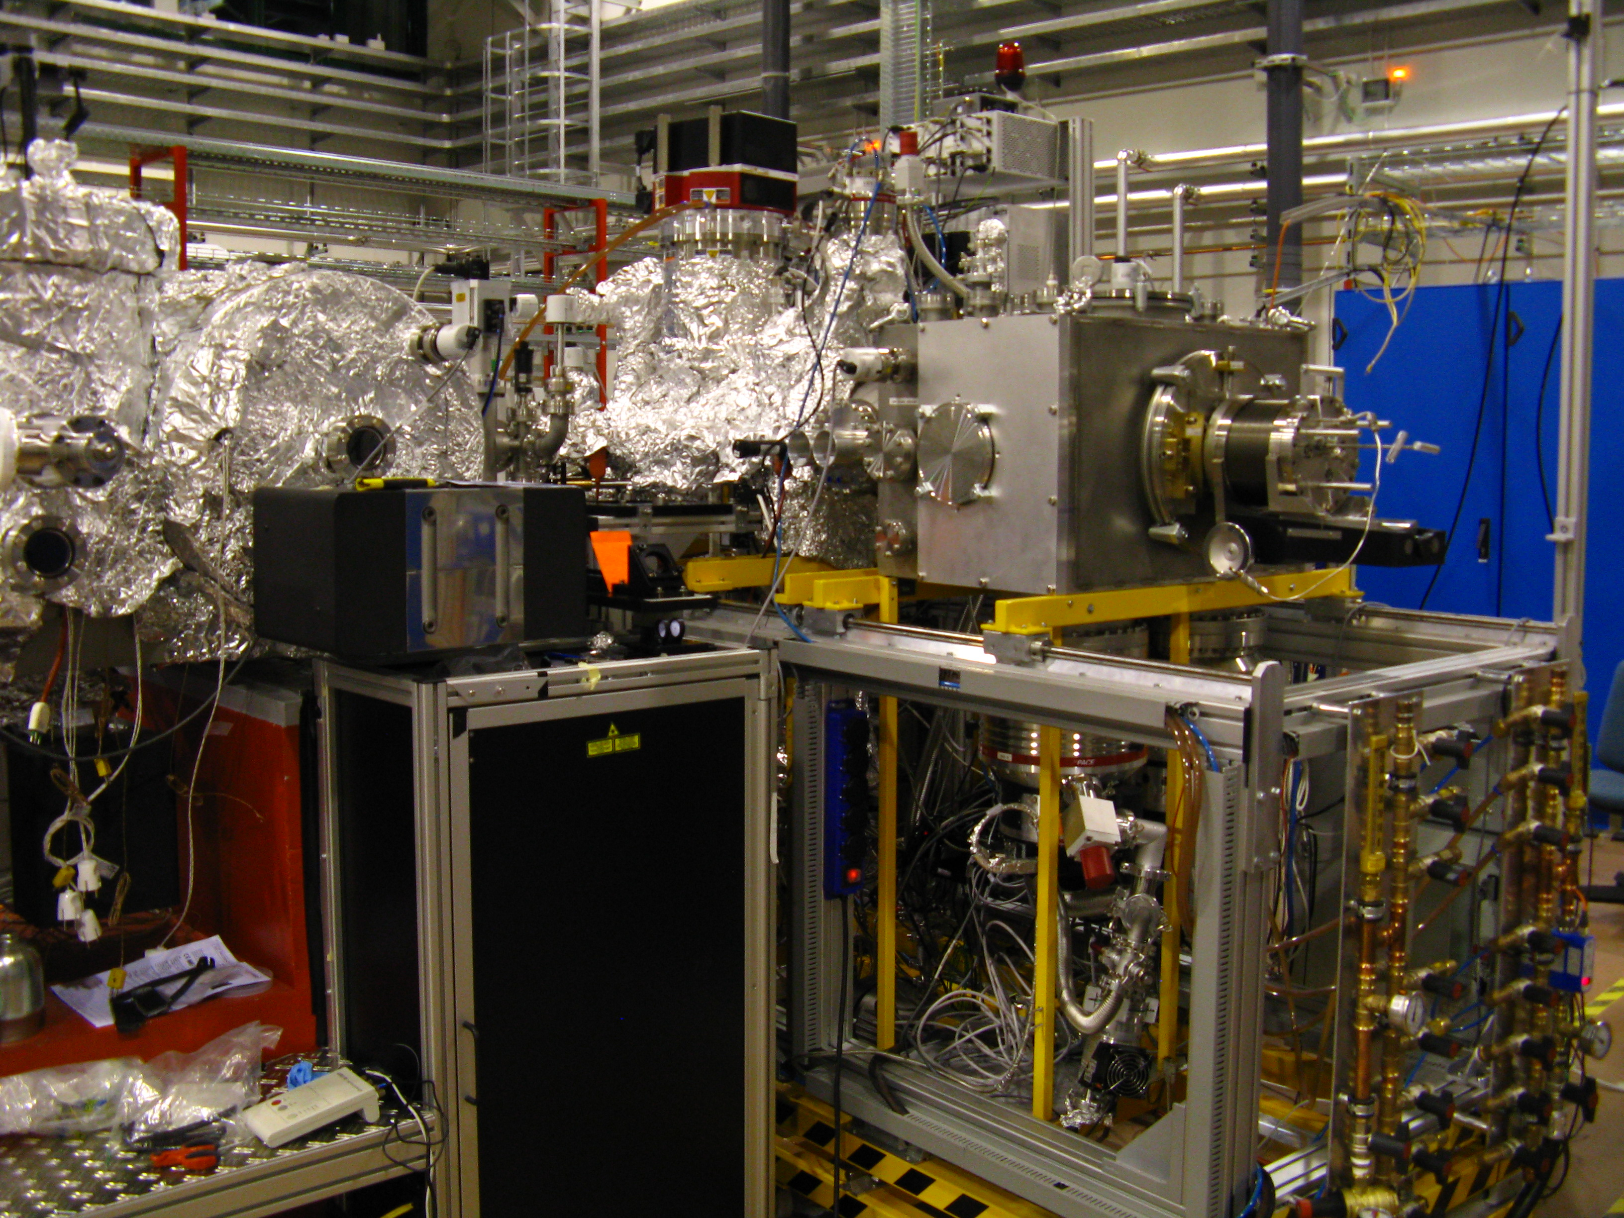
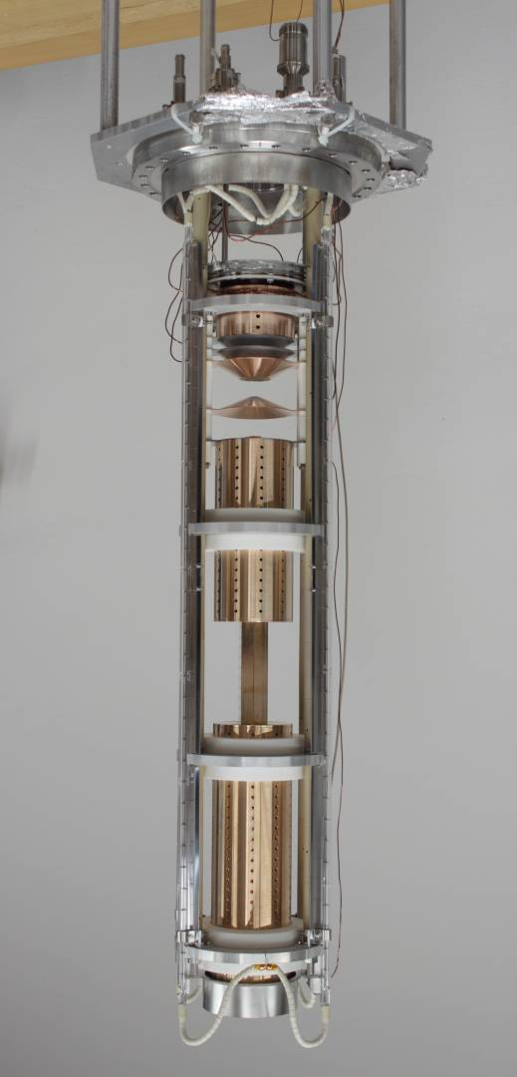
LDM@FERMI
Our last 8 m!
Dr. C. Callegari
Low Density Matter
end-station
Prof. F Stienkemeier
K-B mirrors
(adjustable focussing)
Detectors
Supersonic beam source(s)
(Seed laser for Users)
He nanodroplets
Clusters (Rg, H₂O)
Molecules, Radicals
Metal nanoparticles
IR laser
optics
V. Lyamayev, et al. J. Phys. B 46 (2013) 164007.
C. Svetina, et al.J .Synchrotron Rad. 22 (2015) 538.

Slide 23
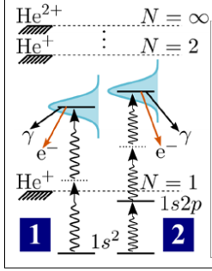
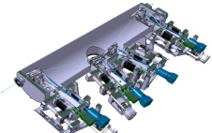
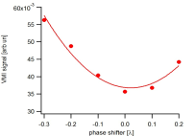
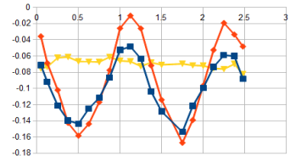
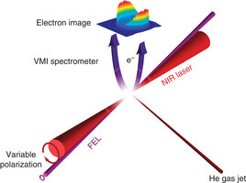
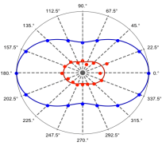
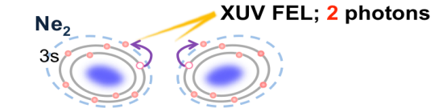
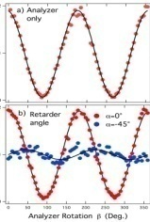
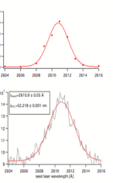
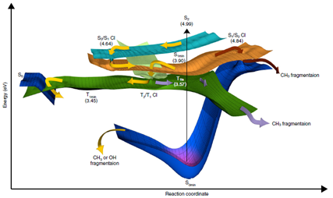
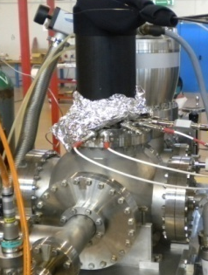
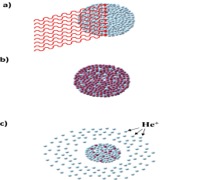
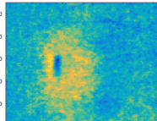
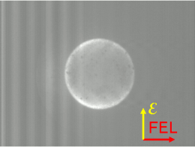
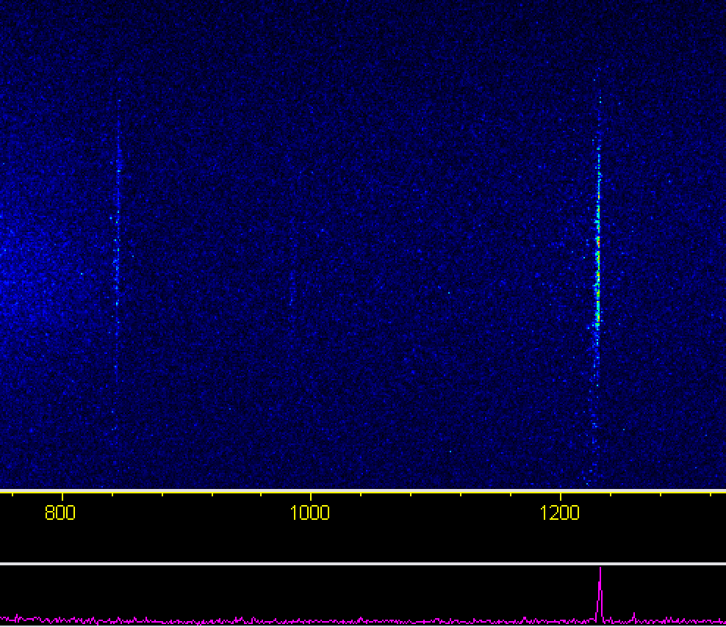
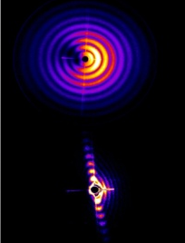
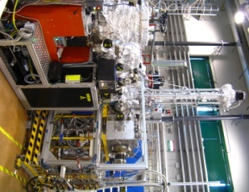
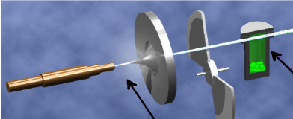
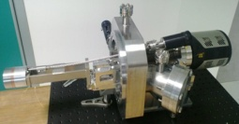
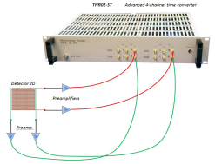
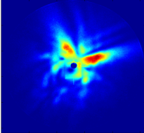
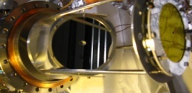


LDM @FERMI
Science and technology ^{(2011 – 2018)}
A lot of cutting edge and interesting science can be driven at LDM and FERMI
FEL control
(CPA, polarization)
Coherent control
Multi-photon; multi-
electron (correlation)
atoms➔molecules➔clusters
FEL characterization (polarization, tuning, harmonics, time)
Spectroscopy
Molecular Photodynamics
ICD➔nanoplasma
Instrumentation development
(charged particles, photons)
Sample sources development
atoms, molecules,
metastable targets,
clusters, radicals, …

Slide 24





UV
FEL1
A recent example
Acetylacetone photoexcitation dynamics
MN Piancastelli
This molecule exists as two tautomers, and the enol is more stable at room temperature.
UV
keto
enol
Hush et al., Aust. J Chem.
40, 599 (1987)
On photoexcitation, it dissociates.
-0.25 ps
The experiment
excite (pump) with UV light,
then probe the valence band with FEL light after a given time.
0.00 ps
+0.25 ps
The photoelectron peaks identify the species present.
+10 ps
Prof. R.Feifel
Magnetic Bottle
UniGoteborg

Slide 25

Atomic, Molecular, Cluster and Opitcal Physics
Beamlines and End Stations
Atoms
Molecules
Clusters
High rep rate, “few” photons/pulse,
spectroscopy and ps-ns dynamics
GasPhase@Elettra May 1997
λ | 90–1.3 nm
hν | 13.5–900 eV
flux (ph/s) | 10¹² @ 40 nm
Pulse length | 100 ps
Repetition rate | 499 MHz
laboratory fs-VUV source
Ajdovščina, Uni Nova Gorica (Slo)
CITIUS (HHG) : March 2018[*]
hν | 12–80 eV
pump | 800 nm
OPA | 3000-200 nm
flux (ph/shot) | 2x10⁷ @ 40 nm
Pulse length | 35 fs
Repetition rate | 5 (10) kHz
Low rep rate, “many” photons/pulse,
non linear processes and fs (ps) dynamics
LowDensityMatter@FERMI Dec 2012
λ | 4–100 nm
hν | 12–300 eV
SLU | 783 nm (SHG/THG)
flux (ph/s) | 10¹⁴ @ 40 nm
Pulse length | 100 fs
Repetition rate | 10 Hz
collaboration with UniFreiburg (D)
intermediate situation for rep rate and photon/pulse, suited for ultrafast dynamics
[*] built at Elettra in 2013, then moved to UNG

Slide 26
Conclusions
Our 3 facilities are working and they accept User experiments.
Gas Phase beamline (Elettra)
LDM (FEL-1 and FEL-2)
CITIUS (fs-VUV HHG)
They provide VUV and Soft-X-Rays light pulses to investigate the electronic structure of isolated species and their excited states dynamics from ns to fs.
semester Calls. Next: sem-51, 15.03.2019
towards semester calls; call-10: next winter
(Dec 2019- Jan 2020 )
Targets and methods can thus find their optimal light sources

Slide 27


Towards Elettra 2.0
CiPo+GasPhase =>
MOST: MOlecular Science and Technology
A new XUV beamline at Elettra, Trieste
Technical specifications include
Polarization control via modern undulators
Wide energy range from 8 eV to above 1 keV, with high and low energy monochromators and branchlines
Suppression of harmonics at low energy (aperiodic undulator; grating design)
High flux due to efficient undulator design, modern optics (Variable Line Spacing/groove-depth, etc.)
Integrated design, allowing efficient use of optical laser for pump-probe.

Slide 28
Carlo Callegari
Oksana Plekan
Michele Di Fraia
LDM
“Milano Group”
Paolo Piseri
Tommaso Mazza
OP
Michele Devetta
Luca Bettini
-
PCCP@Elettra
de
Finetti
diagram
CC
MDF
of people and
sources
involved
PP
CG
LB TM
“Romano-Triestini”
Lorenzo Avaldi
Stefano Stranges
Luca Schio
Paola Bolognesi
MDv
MC
KP
MA
AD’E
SS
LS
CS
RR
AK
AC
LA
PB
Kevin Prince
MS
BR
Robert Richter
GDN
MS
MdS
Monica de Simone
Citius
GasPhase
Cesare Grazioli
Carlo Spezzani
Michele Alagia
Barbara Ressel
Primos Rebernik Ribic
Matija Stupar
Thanks
!
Alessandra Ciavardini
Alessandro D’Elia
(
Giovanni De Ninno
to
you
, and
to
all
of
them
Marcello Coreno
)
Notes:
Last Slide 1: Thanks to the audience

